Slide 1
Final Exam Review
Spring 2018

Slide 2
Probability
Probability: The extent to which an event is likely to occur, measured by the ratio of the favorable cases to the whole number of cases possible

Slide 3

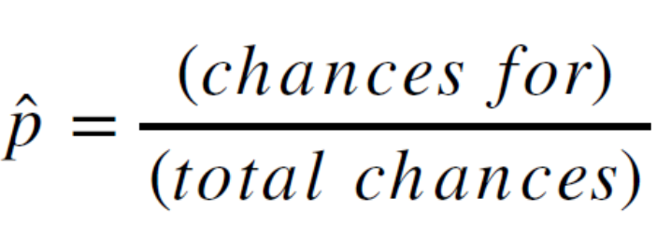
Probability
What is the probability of randomly selecting a square?
There are 12 total shapes and 4 squares
P = 4/12 = 0.333

Slide 4

Odds
Odds: The extent to which an event is likely to occur, measured by the ratio of the number of favorable cases to the number of unfavorable cases

Slide 5
Odds
What are the odds of randomly selecting a square?
There are 8 non-squares and 4 squares
odds = 4/8 = 0.5

Slide 6
Converting between probability and odds
Probability can be easily converted to odds
Odds = probability / (1-probability)
Odds can be easily converted to probability
Probability = odds / (1+odds)

Slide 7
Risk Ratio
The risk ratio, or relative risk, is the ratio of the probability of an outcome for one group compared to the probability of the outcome for another group.
E.g. the probability of a man having a heart attack is 0.12; the probability of a woman having a heart attack is 0.05.
What is the risk ratio of heart attack for males compared to females?
RR = p1/p2 = 0.12 / 0.05 = 2.4
The probability of heart attack for men is 2.4 times higher than for women.

Slide 8
Odds Ratio
The odds ratio is a comparison of the odds of an event occurring for one group compared to another group.
E.g. The odds of having skin cancer for individuals who never use sunscreen are 3.2; the odds of skin cancer for individuals who regularly use sunscreen are 1.1
What is the odds ratio of contracting skin cancer for people who don’t use sunscreen vs. people who use sunscreen?
OR = odds1 / odds2 = 3.2 / 1.1 = 2.91
The odds of having skin cancer for individuals who don’t use sunscreen are 2.91 times higher than for individuals who use sunscreen

Slide 9
Logistic Regression
A clinical psychologist has developed a new intervention for Obsessive Compulsive Disorder. Participants in a clinical trial were randomly assigned to receive the new intervention or no intervention. One year later they were assessed to determine if they had been cured.
Variables:
Intervention: 0 = “No intervention”; 1 = “Intervention”
Cured: 0 = “Not cured”; 1 = “Cured”

Slide 10
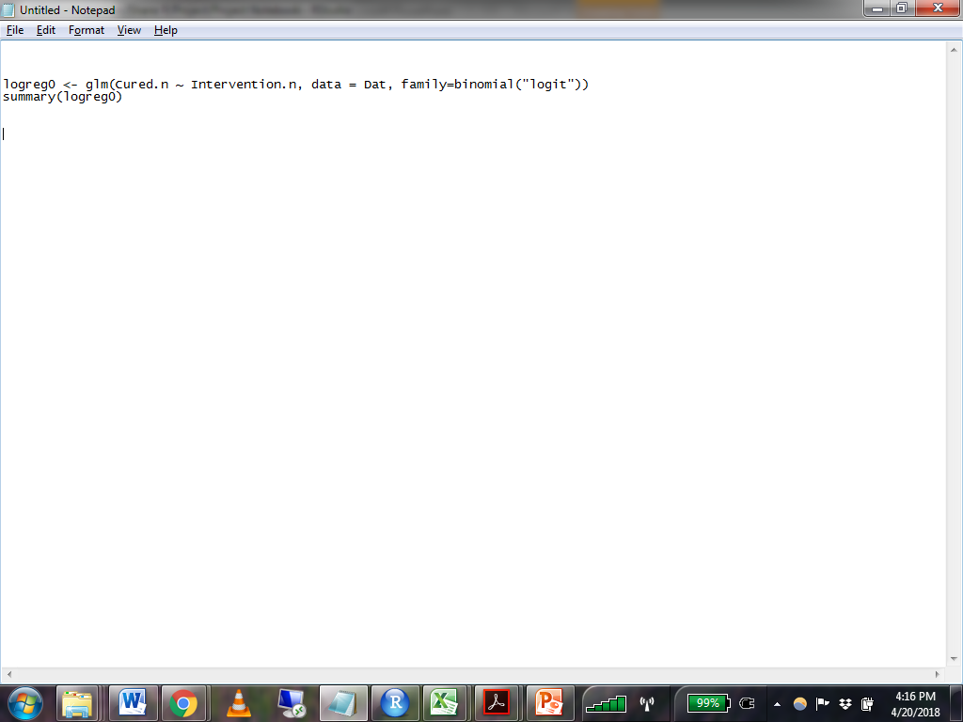
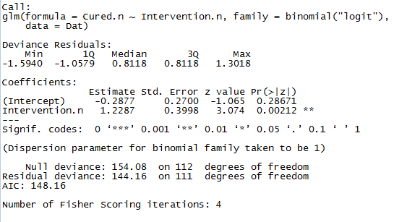
Logistic Regression

Slide 11
Logistic Regression Interpretation
The unit of logistic regression parameters is the natural log of odds: ln(odds)
Intercept
The predicted ln(odds) for participants who did not receive the intervention (i.e. Intervention = 0)
Coefficient for Intervention
The mean difference in ln(odds) between the group that received the intervention and the group that did not

Slide 12
Logistic Regression Interpretation
Odds Ratio
Ln(odds) is not intuitively interpretable, but we can exponentiate parameter estimates to obtain odds ratios
When the predictor is categorical, the odds ratio compares the odds of an outcome occurring for two groups
When the predictor is continuous, the odds ratio indicates the change in odds for every one unit increase in the predictor.

Slide 13
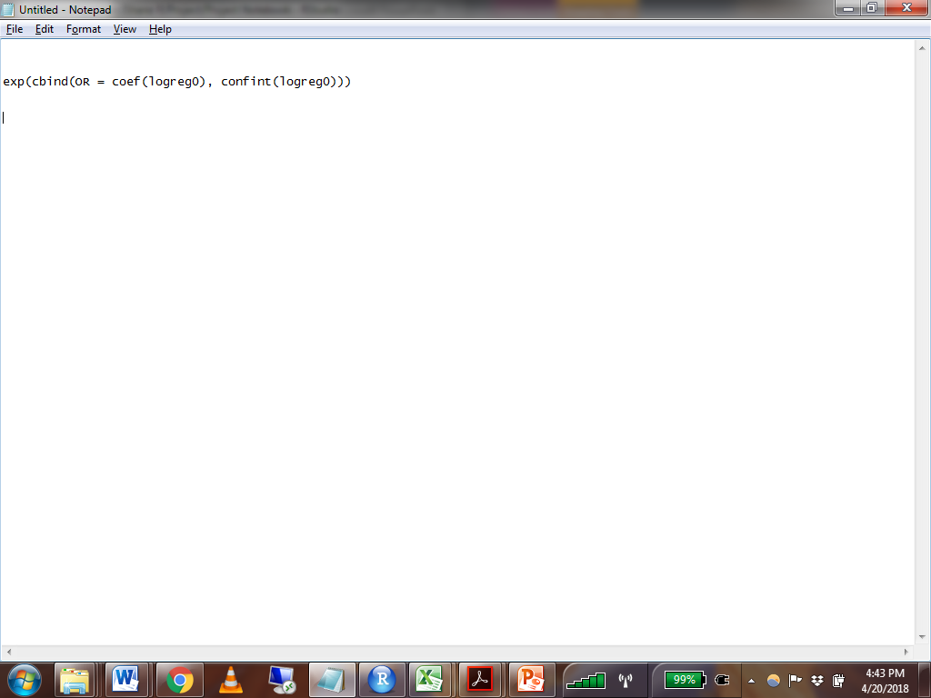
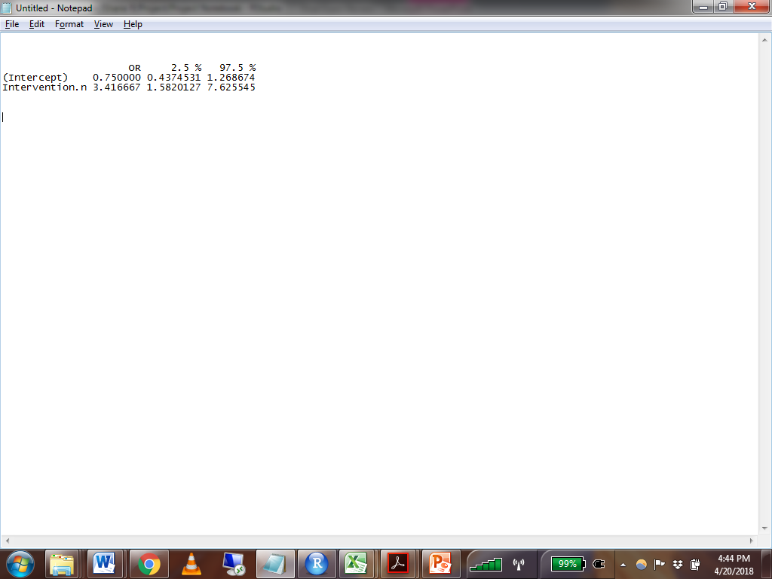
Logistic Regression Interpretation
The odds ratio for Intervention indicates that, on average, the odds of being cured are 3.42 times higher for individuals who received the intervention compared to those who did not.
The null hypothesis corresponds to an odds ratio of 1. Our confidence interval does not contain 1, so the odds ratio is statistically significant.

Slide 14
Predicted Probability
Predicted Probability
Probability is easier than odds for most people to comprehend
In order to interpret our results, we may want to calculate the probability of the outcome occurring for an individual with a certain combination of values on the predictors.
We can do this in three steps
1. Use the regression equation to calculate ln(odds)
2. Exponentiate ln(odds) to get odds
3. Convert from odds to probability
What is the predicted probability for an individual who received the intervention?

Slide 15
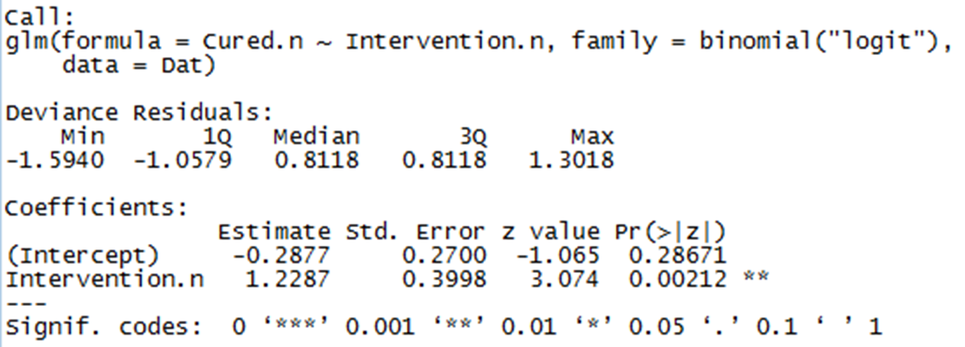
Predicted Probability
1. Use the regression equation to calculate ln(odds)
ln(odds) = -0.2877 + 1.2287(Intervention)
ln(odds) = -0.2877 + 1.2287(1)
ln(odds) = 0.941

Slide 16
Predicted Probability
2. Exponentiate ln(odds) to get odds:
Odds = e^{ln(odds)}
ln(odds) = 0.941
Odds = e^{0.941} = 2.562
3. Convert from odds to probability
Probability = odds / (1+odds)
Probability = 2.562 / (1 + 2.562) = 0.7192
The probability of being cured for an individual who receives the intervention is 0.7192

Slide 17
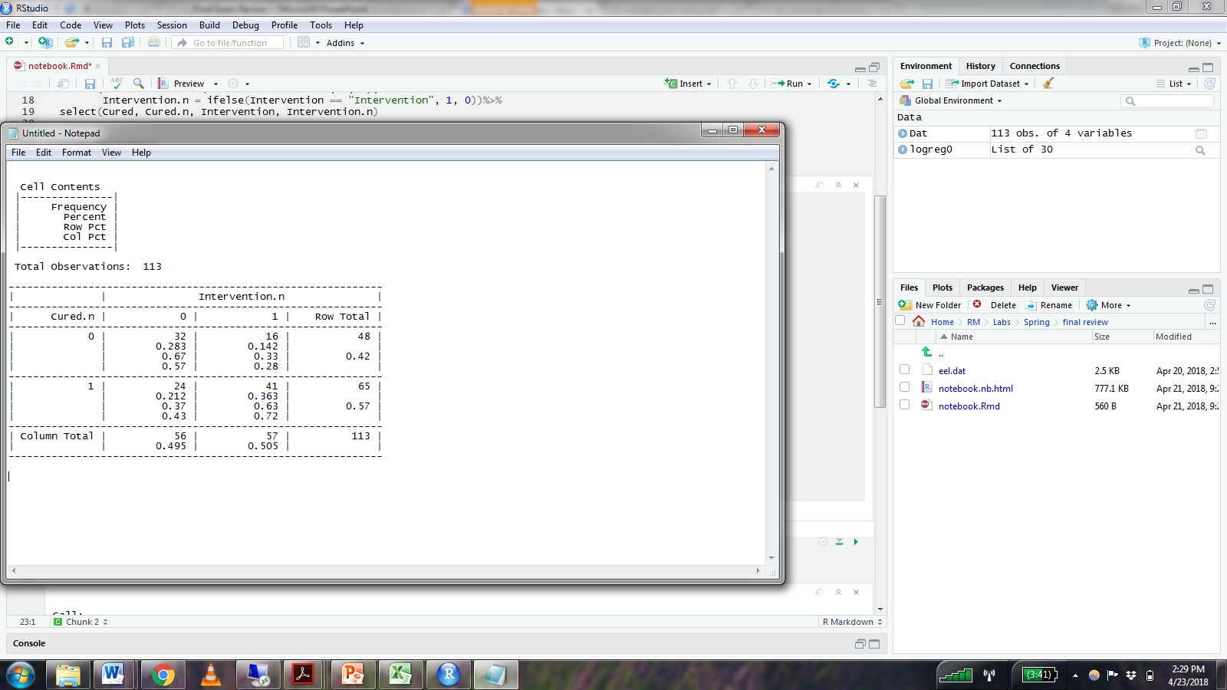
Predicted Probability
Because we only have a single binary predictor, we can double check our predicted probability for this example by looking at the 2 x 2 cross table.

Slide 18
Predicted Probability
Total number of subjects in intervention condition:
57
Number of cured subjected in intervention condition:
41
Probability of being cured for individuals in the intervention condition:
41 / 57 = 0.719

Slide 19
Multilevel Modelling
Example from Discovering Statistics Using R
Quality of life following cosmetic surgery from 10 different clinics. Data are nested within clinic.
Variables:
Post_QoL –
Quality of life following cosmetic surgery
Reason-
Dummy coded variable indicating whether surgery was for medical reasons (1) or aesthetic reasons (0)
ClinicRating-
Average customer review for each clinic (1-5 stars)
Clinic-
ID variable for clinic

Slide 20
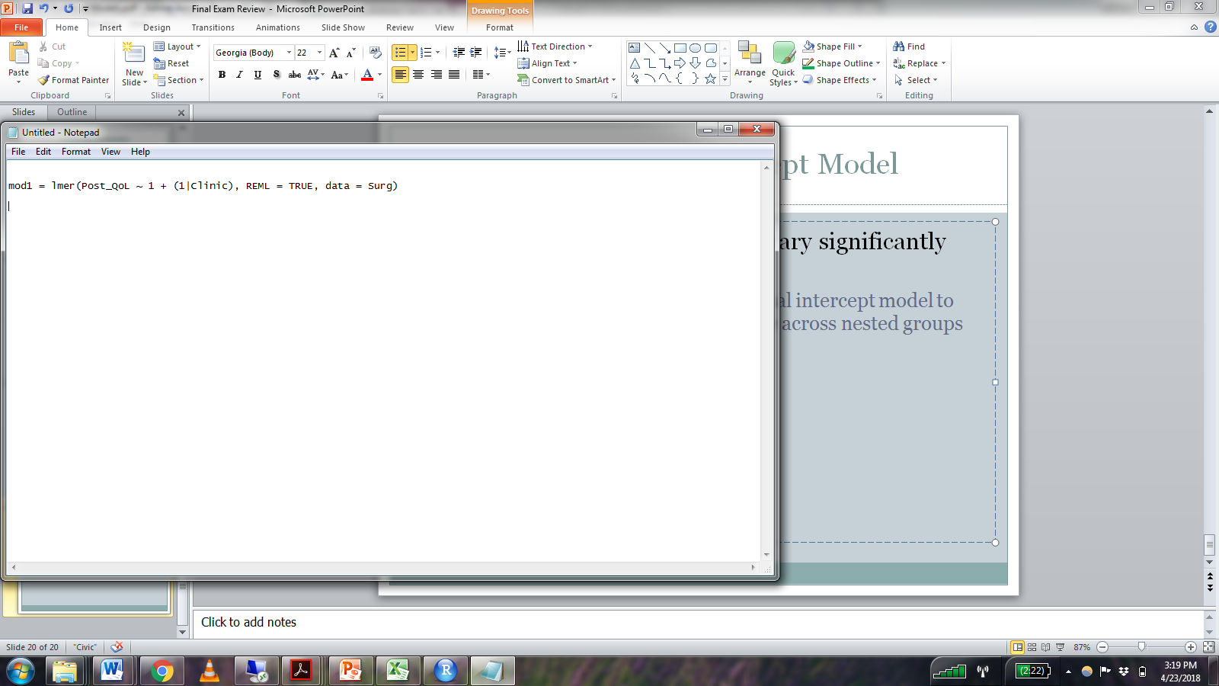
Unconditional Intercept Model
Does post-surgery quality of life vary significantly between clinics?
We start by estimating an unconditional intercept model to examine the variability of our outcome across nested groups
An unconditional intercept model contains no predictors and a random effect for the intercept
It provides information about the grand mean (the mean of group means) and how the outcome varies around the grand mean.

Slide 21

Unconditional Intercept Model
The fixed effect for the intercept is the grand mean (mean of group means) for Post_QOL

Slide 22
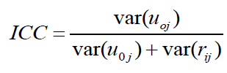
Does post-surgery quality of life vary significantly between clinics?
Intraclass Correlation (ICC)
The proportion of variance in a Level 1 variable that is due to between group difference
ICC = 39.03 / (39.03 + 52.40)
ICC = 0.427
42.7% percent of variability in post-surgery QOL is attributable to differences between clinics

Slide 23
Does Reason for surgery predict Post_QOL?
Reason for surgery is a level 1 variable. It varies within clinic
Next, we’ll fit a model with a random intercept and a random effect for Reason

Slide 24
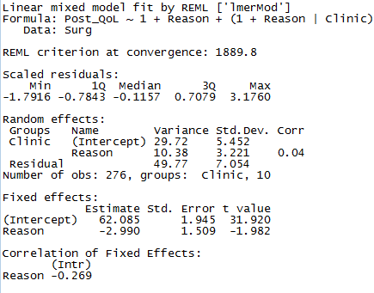
Output

Slide 25
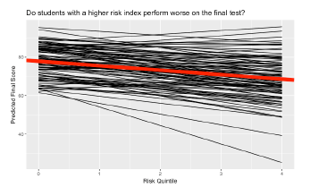
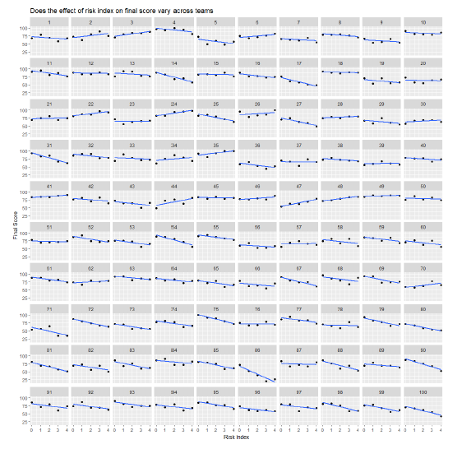
Interpretation
In multilevel modelling, a unique regression equation can be written for each group

Slide 26
Interpretation of fixed effects
To interpret fixed effects for a given parameter, first think about the interpretation at the within-group level.
Intercept:
The intercept represents the grand mean across clinics of Post_QOL for patients who have surgery for aesthetic motives (Reason = 0)
The fixed effect is the average value of this parameter across all groups

Slide 27
Interpretation
In multilevel modelling, a unique regression equation can be written for each group

Slide 28
Interpretation of fixed effects
Intercept (full interpretation):
The intercept represents the predicted post-surgery quality of life score for individuals who had surgery for aesthetic reasons, averaged across all clinics.
Reason
What does the estimate for Reason represent at the clinic level?

Slide 29
Output

Slide 30
Interpretation
In multilevel modelling, a unique regression equation can be written for each group

Slide 31
Interpretation of fixed effects
Reason (full interpretation)
The predicted post-surgery quality of life is 2.99 point lower for individuals who had surgery for medical reasons compared to individuals who had surgery for aesthetic reasons, averaged across all clinics.

Slide 32
Does Clinic Rating predict QOL?
ClinicRating is the average of all patient reviews for a given clinic (0-5 stars).
It is a level 2 predictor: it does not vary within clinics, so it can only be modelled as a fixed effect.
Post_QoL | Reason | Clinic | ClinicRating
71.3 | 0 | 1 | 5
77 | 1 | 1 | 5
73 | 0 | 1 | 5
68.9 | 1 | 1 | 5
69 | 0 | 1 | 5

Slide 33
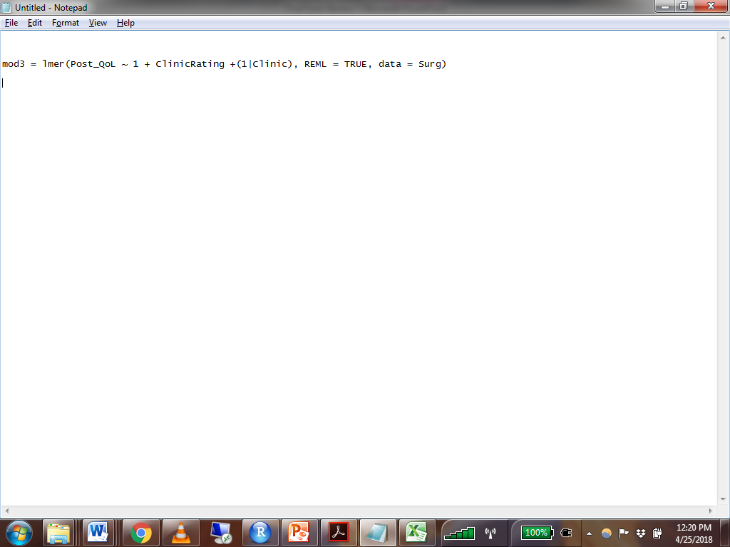
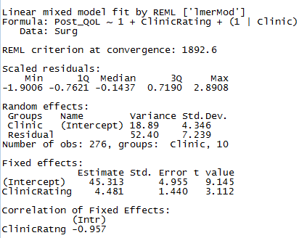

Slide 34
In this model, the intercept is allowed to vary but not the slope for ClinicRating

Slide 35
Interpretation
Intercept
The intercept is the predicted Post_QOL score for each clinic if that clinic had a rating of zero, averaged across all clinics.
Clinic Rating
The slope for ClinicRating indicates that for all clinics, every one unit increase in ClinicRating corresponds to a predicted increase of 4.481 in Post_QOL.

